Slide 1
GCD week 7 - MongoDB

Slide 2
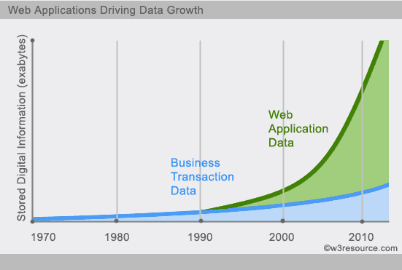
Why non-OLAP data?

Slide 3
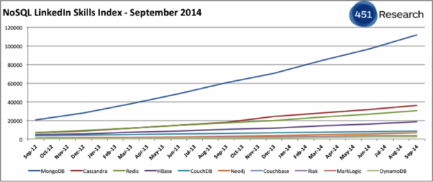
MongoDB
Widely used:

Slide 4
SQL vs NoSQL
Relational model Document model
Tables Collections
Rows Documents
Columns Key/value pairs
Joins Not available (!)

Slide 5
MongoDB Features
Data stored as documents (JSON) – Dynamic-schema
Full CRUD support (Create, Read, Update, Delete)
Ad-hoc queries: Equality, RegEx, Ranges, Geospatial
Atomic in-place updates
Full secondary indexes
Unique, sparse, TTL
Replication–redundancy, failover
Sharding – partitioning for read/write scalability

Slide 6
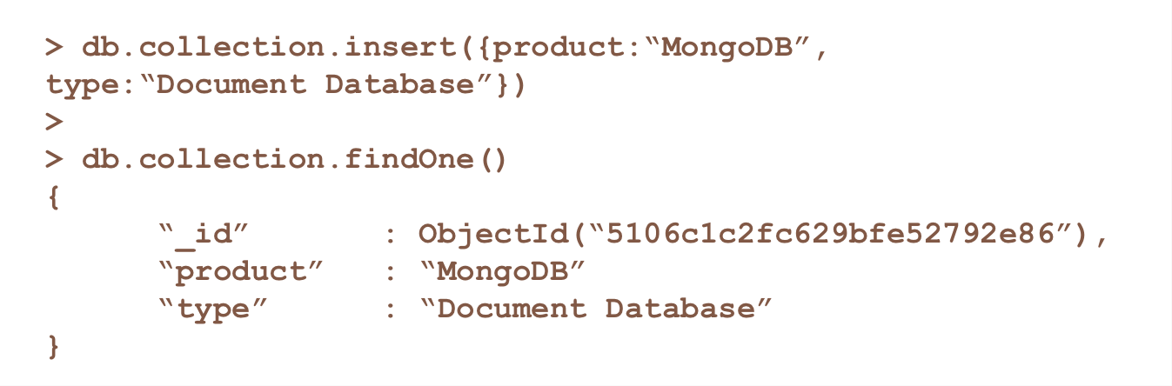
MongoDB Shell
Command-line shell for interacting directly with database

Slide 7
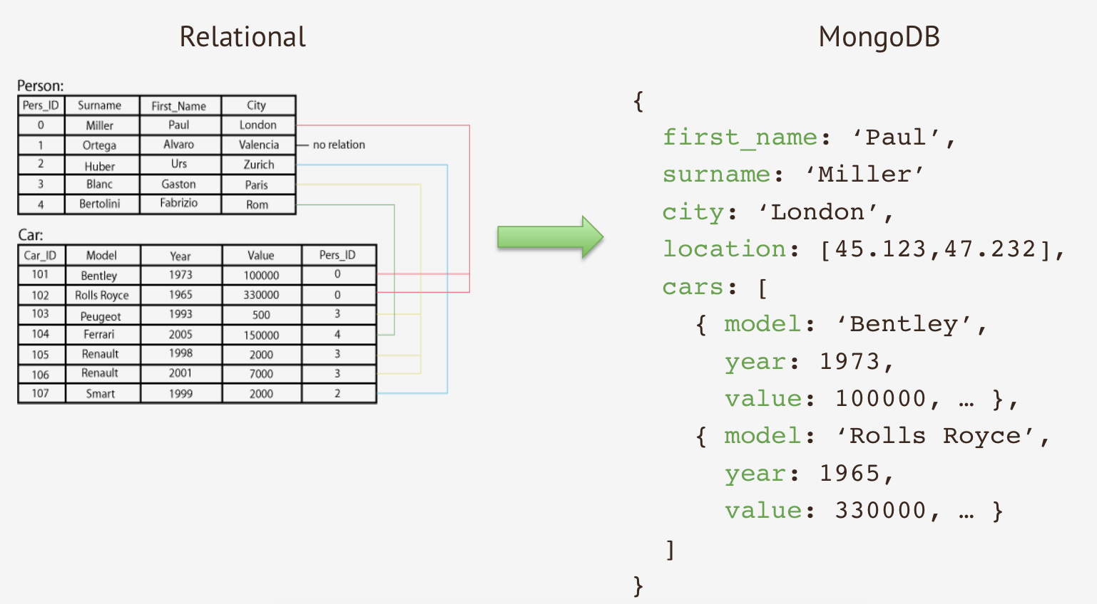
Example database

Slide 8
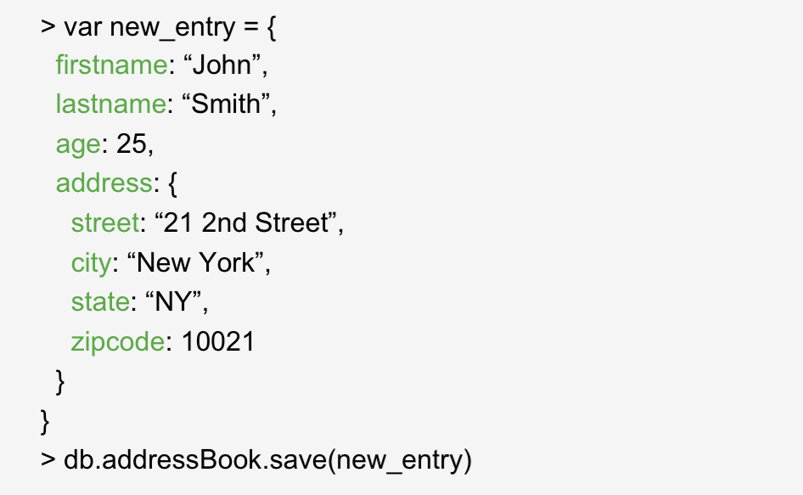
Documents

Slide 9
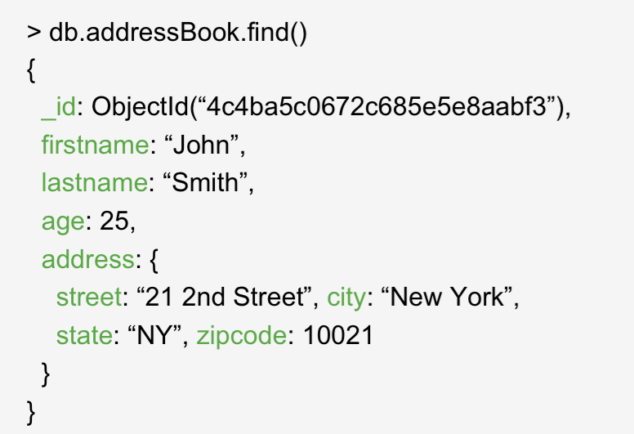
Querying

Slide 10
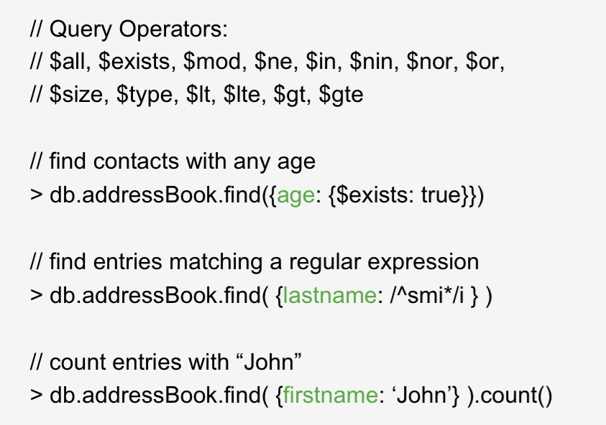
Queries

Slide 11
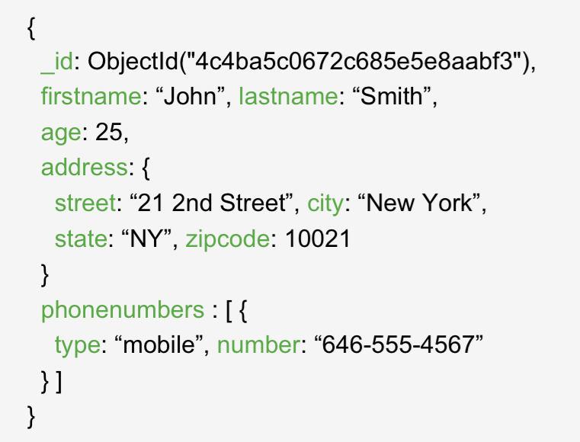
Nested Documents

Slide 12
CRUD operations
•Create
–db.collection.insert( <document> )
–db.collection.save( <document> )
–db.collection.update( <query>, <update>, { upsert: true } )
•Read
–db.collection.find( <query>, <projection> )
–db.collection.findOne( <query>, <projection> )
•Update
–db.collection.update( <query>, <update>, <options> )
•Delete
–db.collection.remove( <query>, <justOne> )
Collection specifies the collection or the ‘table’ to store the document

Slide 13
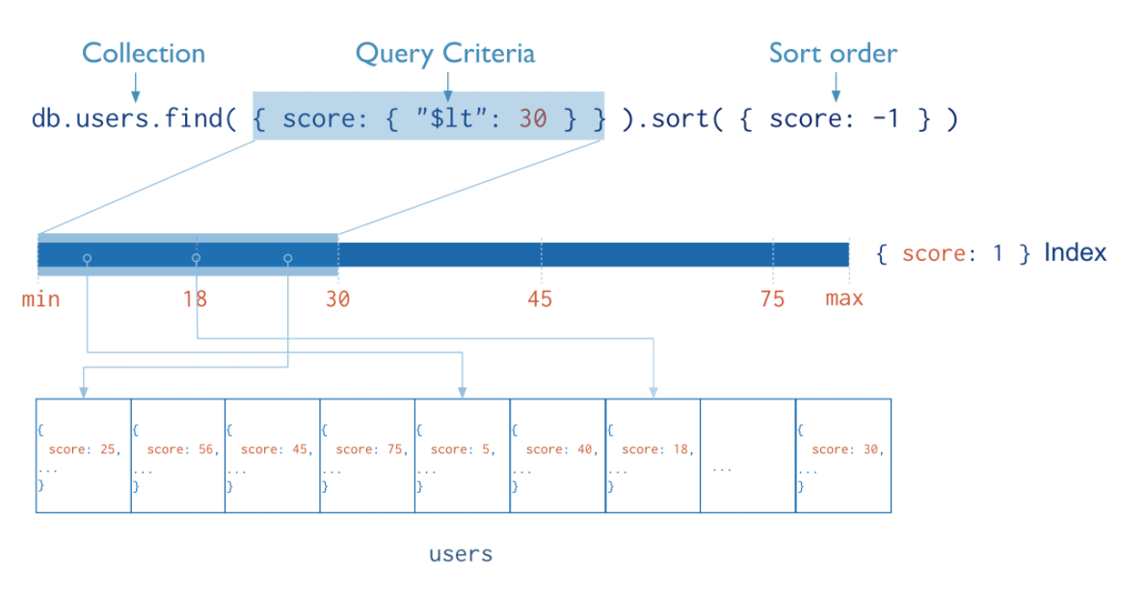
Indexes

Slide 14
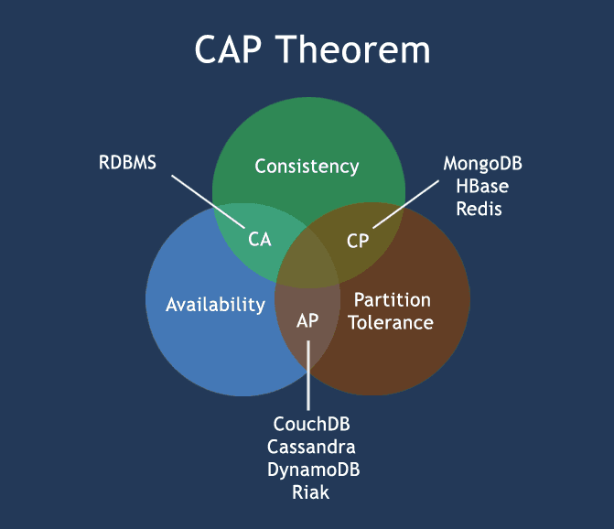

Slide 15
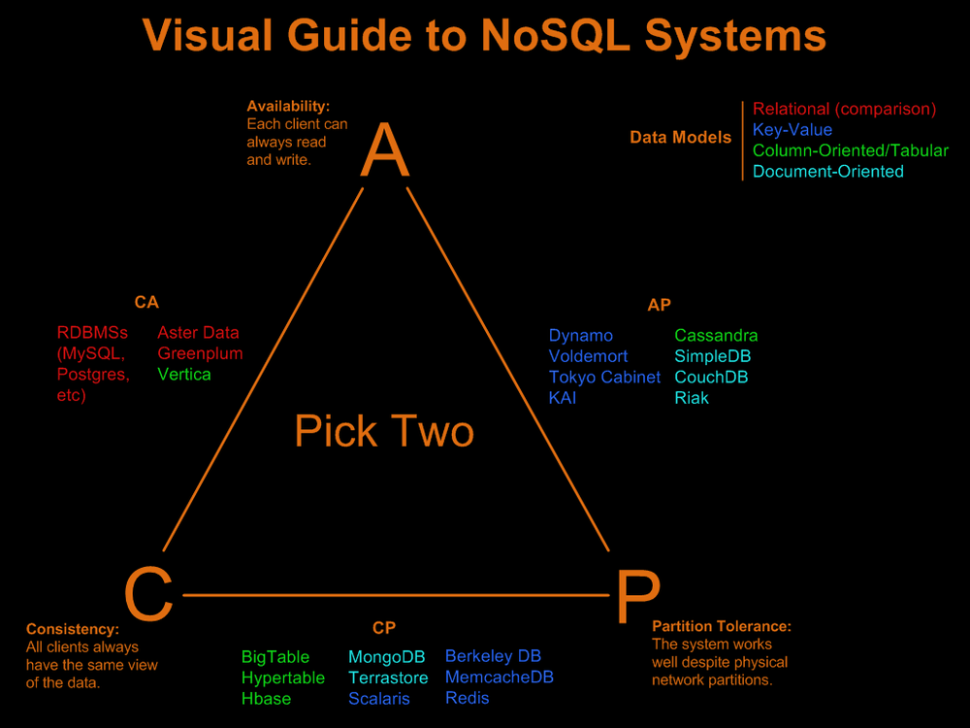
￼
￼

Slide 16
Benefits of NoSQL
Elastic Scaling
– RDBMS scale up – bigger load , bigger server
– NO SQL scale out – distribute data across multiple hosts seamlessly
DBA Specialists
– RDBMS require highly trained expert to monitor DB
– NoSQL require less management, automatic repair and simpler data models
Big Data
– Huge increase in data RDBMS: capacity and constraints of data volumes at its limits
– NoSQL designed for big data

Slide 17
Benefits of NoSQL
Flexible data models
– Change management to schema for RDMS have to be carefully managed
– NoSQL databases more relaxed in structure of data Database schema changes do not have to be managed as one complicated change unit Application already written to address an amorphous schema
Economics
– RDMS rely on expensive proprietary servers to manage data
– No SQL: clusters of cheap commodity servers to manage the data and transaction volumes
– Cost per gigabyte or transaction/second for NoSQL can be lower than the cost for a RDBMS

Slide 18
Drawbacks of NoSQL
Support
–RDBMS vendors provide a high level of support to clients
•Stellar reputation
–NoSQL – are open source projects with startups supporting them
•Reputation not yet established
Maturity
–RDMS mature product: means stable and dependable
•Also means old no longer cutting edge nor interesting
–NoSQL are still implementing their basic feature set

Slide 19
Drawbacks of NoSQL
Administration
–RDMS administrator well defined role
–No SQL’s goal: no administrator necessary however NO SQL still requires effort to maintain
Lack of Expertise
–Whole workforce of trained and seasoned RDMS developers
–Still recruiting developers to the NoSQL camp
Analytics and Business Intelligence
–RDMS designed to address this niche
–NoSQL designed to meet the needs of an Web 2.0 application - not designed for ad hoc query of the data. Tools are being developed to address this need

